Slide 1

Tutorial 3: Statistical Testing: Group Comparisons and Multiple Comparison Corrections in R
Roberto Baratta & Cameron Calv

Slide 2
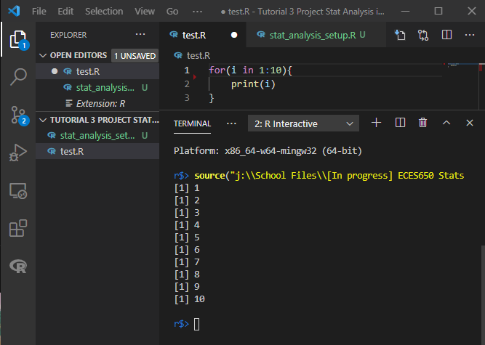
Installing R
Choose OS from this link and install : https://cran.r-project.org/bin/
Decide upon an environment to use (This slide is in VSCode)
VSCode uses two extensions for R, namely the R Extension and the R LSP Client Extension for the radian terminal
Test for proper installation:

Slide 3
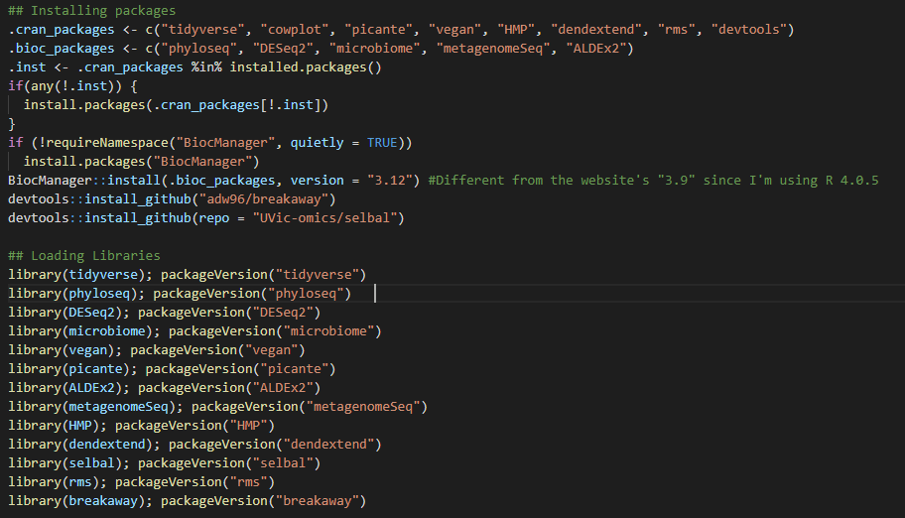
Packages for R 4.0.5
https://www.nicholas-ollberding.com/post/introduction-to-the-statistical-analysis-of-microbiome-data-in-r/

Slide 4
Packages for R 4.0.5
If using R Studio, to run scripts click "Source" to run the whole script

Slide 5
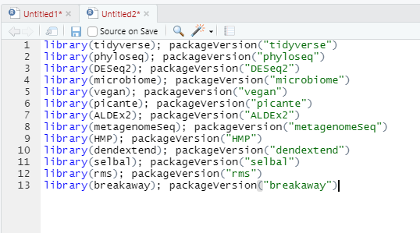
Loading & Checking Packages
It is important to check to make sure all packages were installed correctly
If a package was installed incorrectly use this command:
install.packages("name")

Slide 6
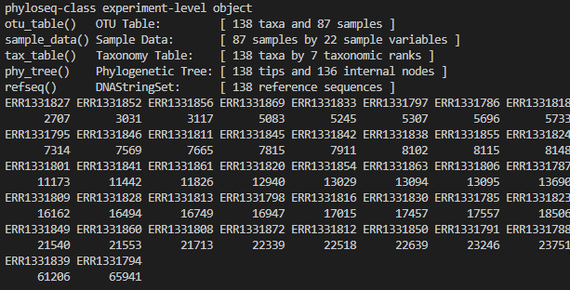

Obtaining Data Gut Microbial Data
ps_giloteaux_2016.rds from https://github.com/Nick243/Create-Giloteaux-2016-Phyloseq-Object/blob/master/ps_giloteaux_2016.rds
Given as a phyloseq object
Place in same directory as the working environment
Load data and sort by read count with:

Slide 7
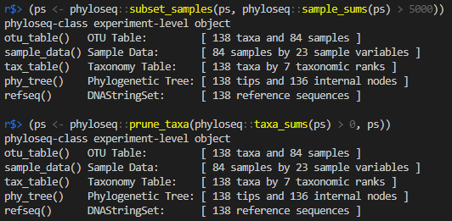
Phylogenetic Data in a phyloseq File
Remove the samples with less than 5,000 total reads:
Remove OTUs (Operational Taxonomic Units) within the remaining samples
*OTUs – Similarly grouped samples not necessarily related via conventional taxonomy. Sometimes develop from sequencing errors.

Slide 8
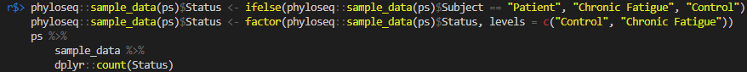
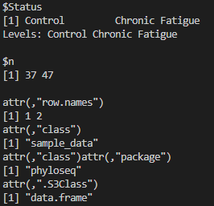
Phylogenetic Data in a phyloseq File
What's our data look like now after adding some metadata?
138 taxa
84 samples (37 controls, 47 patients)
Control: without chronic fatigue
Patient: with chronic fatigue

Slide 9
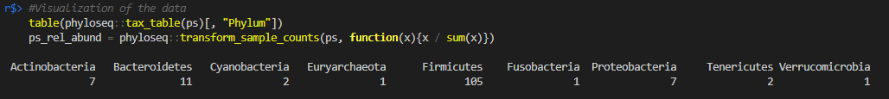
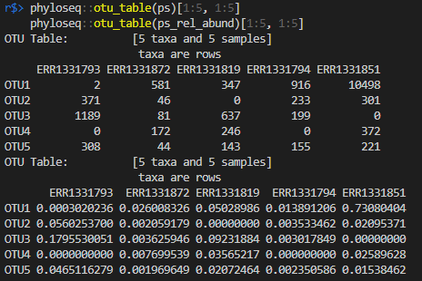
Visualizing Data
Create a phylum-level table:
Then view as relative abundances:

Slide 10
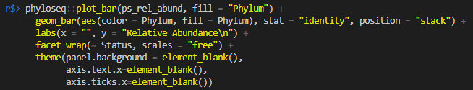
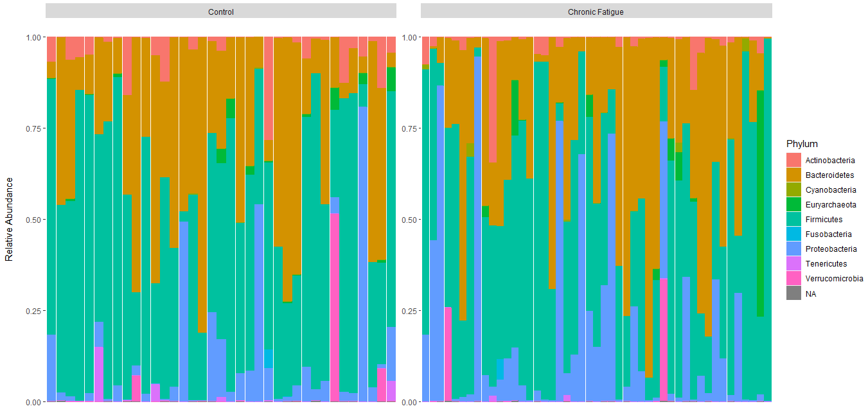
Visualizing Data (Now with Colors)

Slide 11
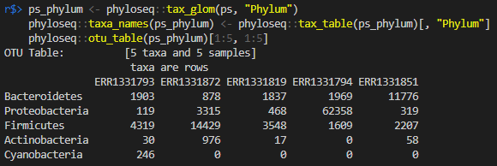
Visualizing Data (Now on the Phylum-level)
Preparing to compare, phylum-by-phylum

Slide 12
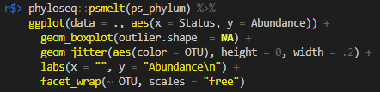
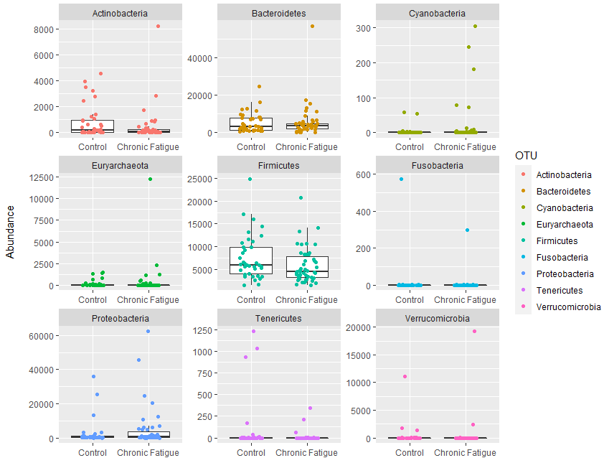
Visualizing Data (Phylum-to-Phylum)
Notice the high abundances:
Firmicutes
Bacteroidetes
Actinobacteria

Slide 13
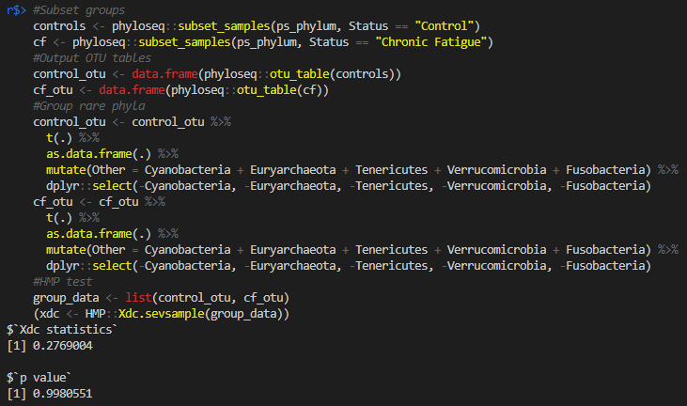

Testing for Abundance Differences (Hypothesis Testing)
Assuming a Dirichlet-Multinomial distribution, we essentially 't-test' between all phyla (or really any taxonomic level)
P-value is too high to reject the null hypothesis.

Slide 14
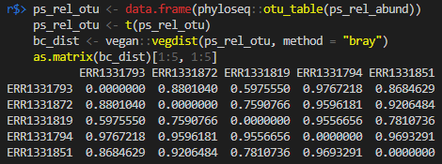
Clustering to Determine Similarity (Bray-Curtis Method)
Bray-Curtis Dissimilarity: 0 for max similarity; 1 for no shared taxa (no similarity)

Slide 15
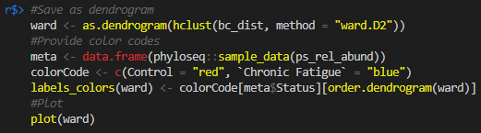
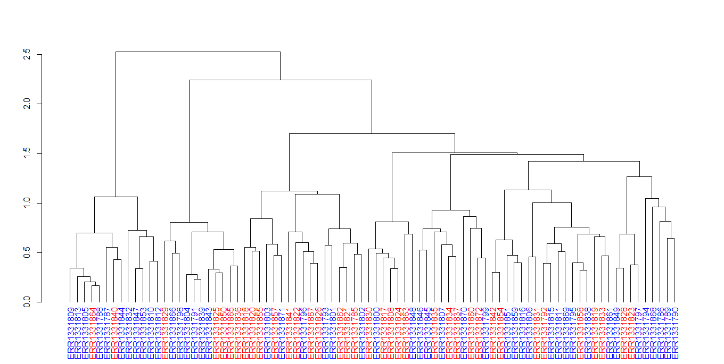
Clustering to Determine Similarity (Visualized as a Dendrogram)
Using the distances to make a phylo-tree
Dissimilarity lower than 0.5
Most similar
Dissimilarity greater than 0.5
Least similar

Slide 16
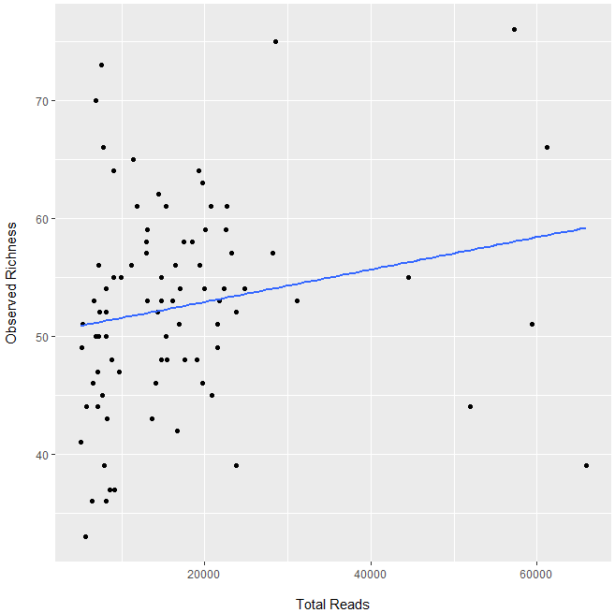
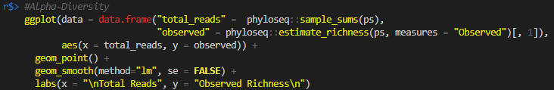
Alpha-diversity: Local Sample Diversity
Testing for differences using such things as richness, Shannon diversity, and phylogenetic diversity

Slide 17
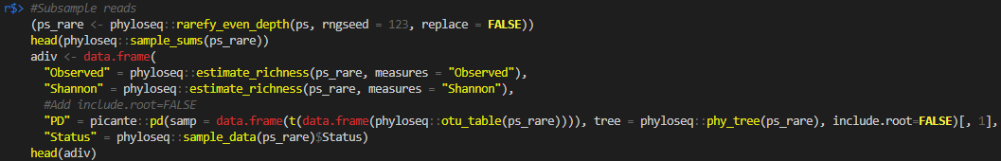
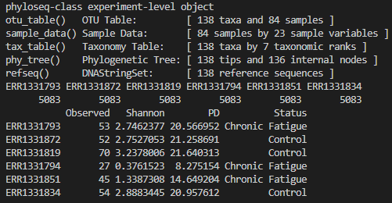
Alpha-diversity: Comparing Metrics (Table Forme)
Split off into subsamples and cross-compare

Slide 18
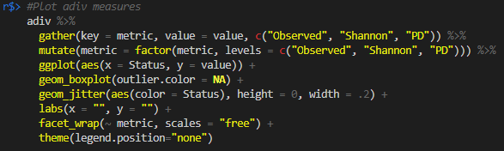
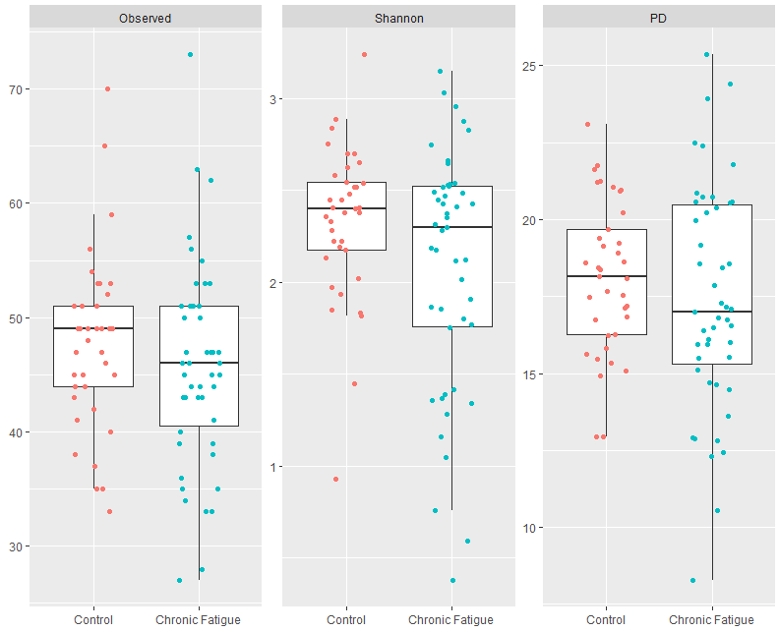
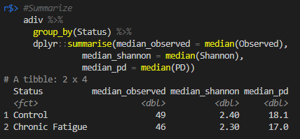
Alpha-diversity: Comparing Metrics (Plot Forme)
Lower alpha-diversity for chronic patients

Slide 19
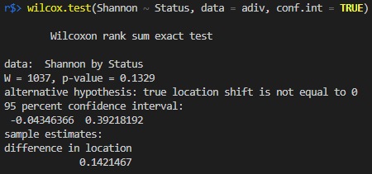
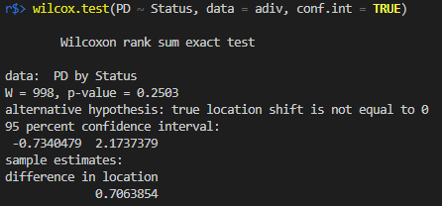
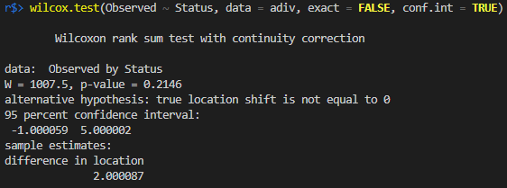
Alpha-diversity: Comparing Metrics (Wilcoxon Rank Sum Tests)
Fail to Reject
Fail to Reject
Shannon Entropy
PD
Fail to Reject
Observed
Notes:
P-value is less than 'difference in location' each time, failing to reject the null hypothesis

Slide 20
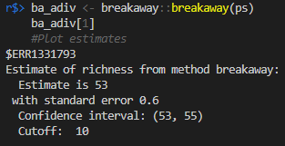
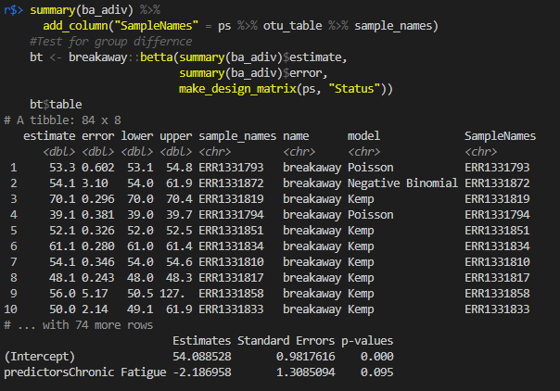
Richness using thebreakaway Package
Form breakaway estimates:
Summary of Estimates:

Slide 21

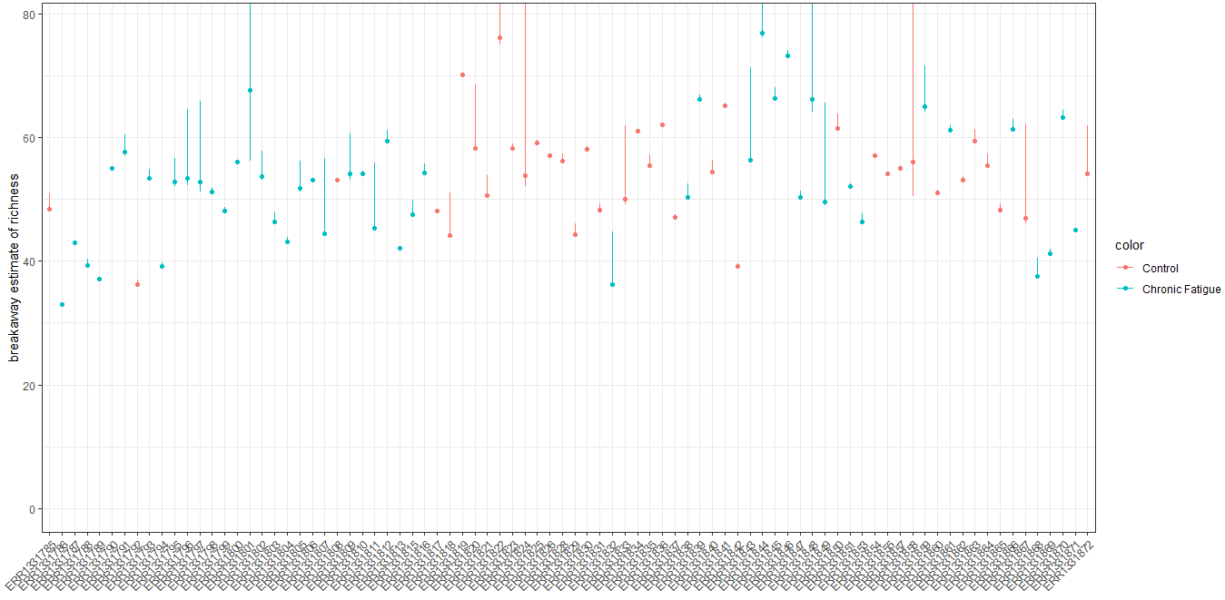
Richness using thebreakaway Package (Plots)

Slide 22
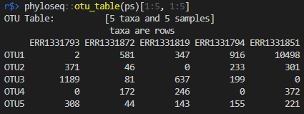
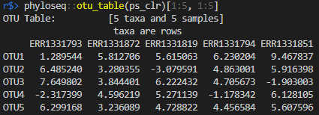
Beta-diversity: Regional to Local Diversity Ratios
Create the CLRs (centered log-ratios)
Untransformed values (counts):
Transformed values (log dominance):

Slide 23
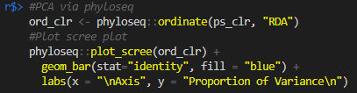
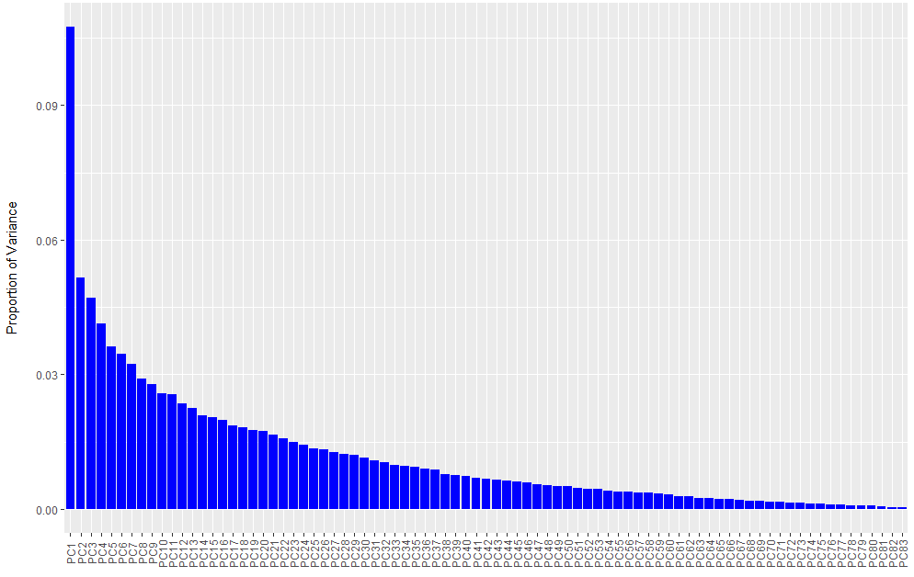
Beta-diversity: Regional to Local Diversity Ratios (continued)
Apply PCA (Principal Component Analysis)

Slide 24


Beta-diversity: Eigenvalues and Principal Components
Eigenvalues
Proportion of Variance explained by Principal Component

Slide 25
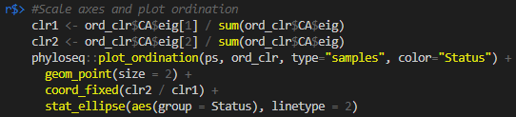
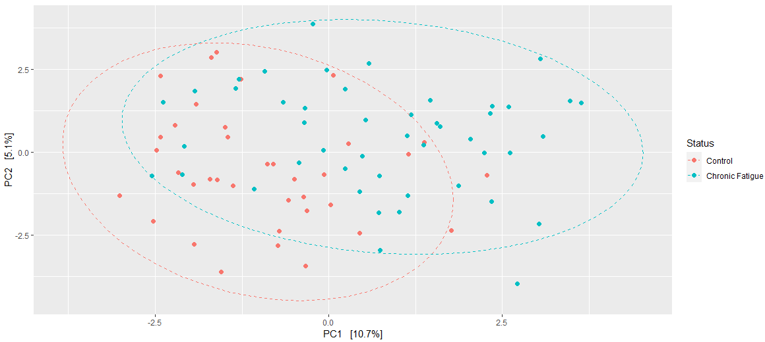
Beta-diversity: The First Two Principal Components
Notice the slight separation between the Control and the Fatigued

Slide 26
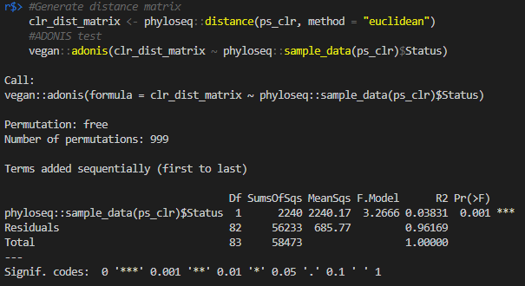
Beta-diversity: PERMANOVA and adonis

Slide 27
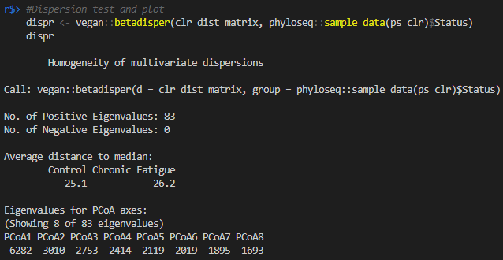
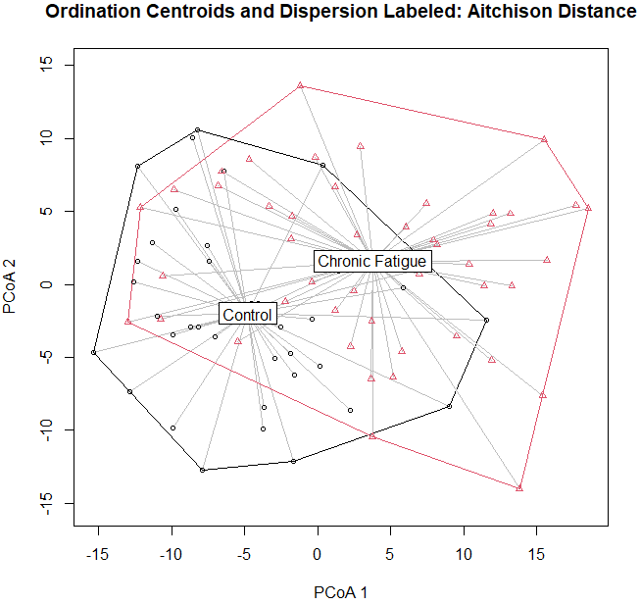
Beta-diversity: PERMANOVA and adonis (Plot and Dispersion Test)
Dispersion Test
PCoA Plotted

Slide 28
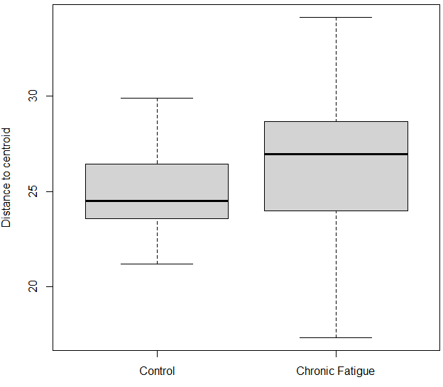
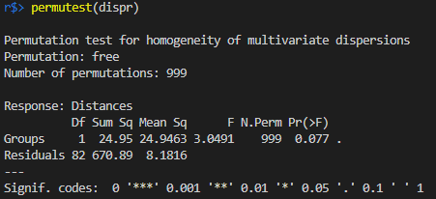
Beta-diversity: PERMANOVA and adonis (Box and Permutation)
PCoA Plot as Box
Permutation Test

Slide 29
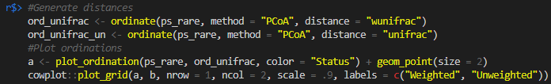
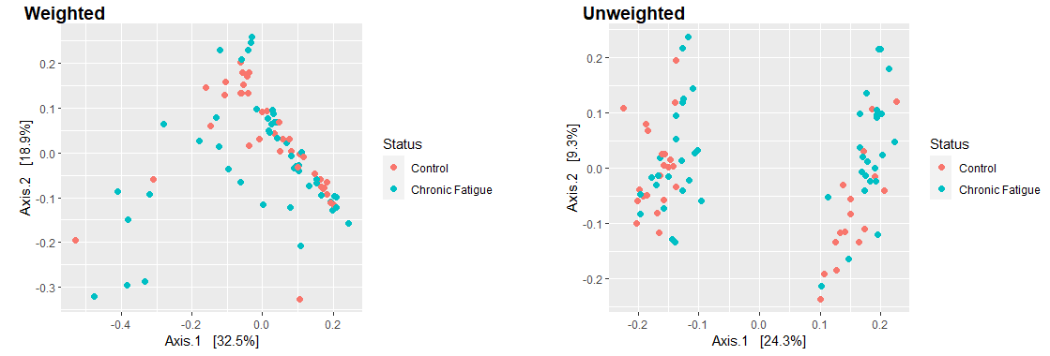
Principal Coordinate Analysis and the UniFrac Distance
Using PCoA to computer similarity as the UniFrac distance

Slide 30
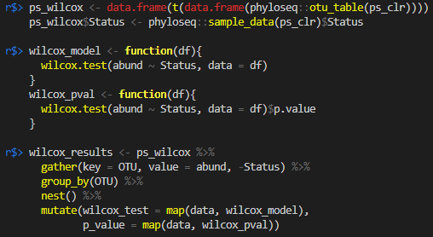
Differential Abundance Testing
Identifying taxa that respond the greatest to changes in some condition
Statistically difficult due to sampling issues
Two Main Approaches:
Non-parametric Wilcoxon rank-sum test
Modified Wilcoxon test for NGS data
NGS (Next Generation Sequencing)

Slide 31
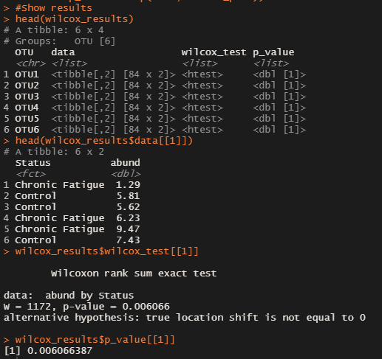
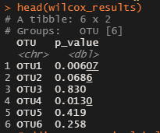
Differential Abundance Testing (Unmodified Wilcoxon)
Test results including:
Abundance fields
Status fields
P-Values

Slide 32
Differential Abundance Testing (Modified Wilcoxon)
Unpack all test values and make some more transforms
Modified test shows many Clostridiales organisms as being 'differentially abundant'
In the 'Order' column of the output

Slide 33
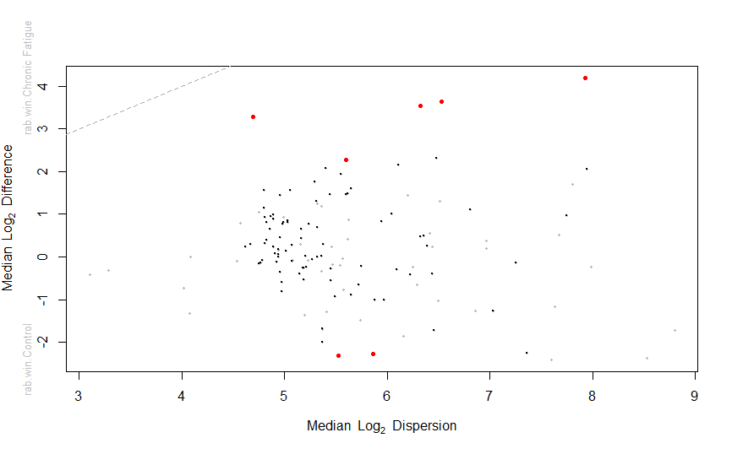
Differential Abundance Testing (ALDEx2)
ALDEx2 (ANOVA-like differential expression) does quite a few things:
Generate 128 Monte-Carlo posterior probabilities for all 138 taxa
Transform via centered log-ratio
Unmodified Wilcoxon for each taxa per probability
Determine effect size
Determine average p-value per taxa
Determine expected p-values (all instances)
Avoid false positives with BH-FDR (Benjamin-Hochberg False Discovery Rate)

Slide 34
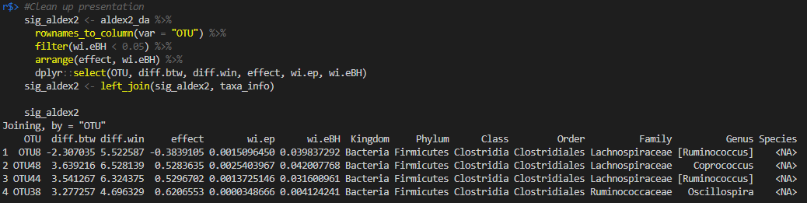
Differential Abundance Testing (ALDEx2)
Which is most abundant according to this test?
The winner is: Clostridiales again!

Slide 35
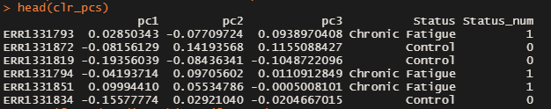

Prediction
Plotting the Principal Component with the outcome of Chronic Fatigue verse control
From the graph there is potential for non-linear association
Better to fit a non-linear on a linear than vice versa as you will have much less penalties
This specifically can be modeled with restricted cubic splines

Slide 36


Prediction (Restricted Cubic Splines)
Fit Restricted Cubic Splines to the model then find the optimum value for the penalty
Can also penalty to differ for simple and complex if we want to allow complexity but down weight the impact

Slide 37


Prediction (Resticted Cubic Splines Plot)
Plot of the penalised log odds
It can be seen that the conditional associations are quite linear
The optimal penalties were 1 for the simple and 200 for the non-linear terms
Effective degrees of freedom shrunk to 2.78

Slide 38

Prediction (Bootstrap Resampling)
Bootstrap resampling is done to find an out-of-sample estimate of model performance
More on discribing this in greator detail: https://thestatsgeek.com/2014/10/04/adjusting-for-optimismoverfitting-in-measures-of-predictive-ability-using-bootstrapping/

Slide 39


Prediction (Resampling Plot)
The Brier score mildly increased but the c-statistic mildy decreased with repeated resampling
The calibration curve shows that the predictions are near the ideal across the range of predicted values
This suggests we can expect to predict patients with chronic fatigue from healthy controls with reasonable accuracy
Must be from similar population using top three principal components

Slide 40

Prediction (Sebal)
"sebal implements a forward-selection method for the identification of two groups of taxa whose relative abundance, or balance, is associated with the response variable of interest."

Slide 41

Prediction (Sebal Accuracy per Variable)
Shows the accuracy of the system per variable
It was already decided that two variables would be used so we focus on that for the balance graph

Slide 42

Prediction (Sebal Balance Graph)
cross-validation shows two balance objects as having the relitively best rank-discrimination
erysipelotrichaceae in the numerator and bifidobacteriaceae in the denominator
The AUC was 0.77, but as low as AUC = 0.68 with 1 repeat of 5 fold cross-validation

